Slide 1
Unit 2 CONTROL AND AUDIT IN IS
4 Hrs
Presented by
Er.Harendra Bikram Shah
Lecturer
Department of BE Computer

Slide 2
OUTLINES
2.1.Control of Information System
2.2.Audit of Information System
2.3.Security of information System
2.4.Consumer layered security Strategy
2.5.Enterprise Layered security strategy
2.6.Extended Validation and SSL-Certification
2.7.Remote access authentication
2.8.Content Control and Policy based encryption
2.9.Example of Security in e-Commerce transaction

Slide 3
Control of Information System
Set of procedures and technological measures to ensure secure and efficient operation of information within an organization.
Information systems controls are classified as:
General controls - controls applying to the whole of an organizations IS activity
Application controls - controls which are specific to a given application (payroll)
Both general and application controls are used for safeguarding information systems.
General controls
Application controls
Input Controls
Processing Controls
output controls.
Software Controls
Hardware Controls
Computer Operations Controls
Data Security Controls
Implementation Controls
Administrative Controls

Slide 4
CONTROLS IN NETWORK INFORMATION SYSTEMS
Firewall
Intrusion Detection System
Antivirus software
AUDIT OF INFORMATION SYSTEM
Examination of the management controls within an Information technology (IT) infrastructure.
Also known as "automated data processing (ADP) audits" and "computer audits".
formerly called as "electronic data processing (EDP) audits".

Slide 5
OBJECTIVE OF IT AUDIT
The IT audit aims to evaluate the following:
Will the organization's computer systems be available for the business at all times when required?
Will the information in the systems be disclosed only to authorized users?
Will the information provided by the system always be accurate, reliable, and timely?
TYPES OF AUDIT:
Technological innovation process audit.
Innovative comparison audit.
Technological position audit.
Systems and Applications.
Information Processing Facilities.
Systems Development
Management of IT and Enterprise Architecture.
Client/Server, Telecommunications, Intranets, and Extranets Audit Processes:

Slide 6
Audit Trail and its Objectives
Audit trail is one of important tool of security of information system in your computer.
It shows the record of who has accessed your system.
What did he or she do?
How much time did he spend in the system?
This record is helpful to control the accounting and other information systems.

Slide 7
OBJECTIVES OF AUDIT TRAIL
Detecting Unauthorized Access to the System
Facilitating the Reconstruction of Events
Promoting Personal Accountability

Slide 8
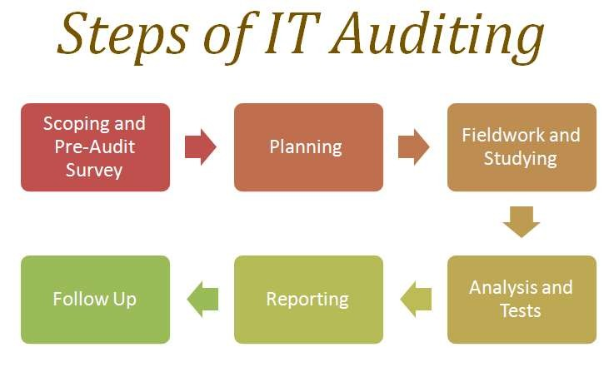

Slide 9
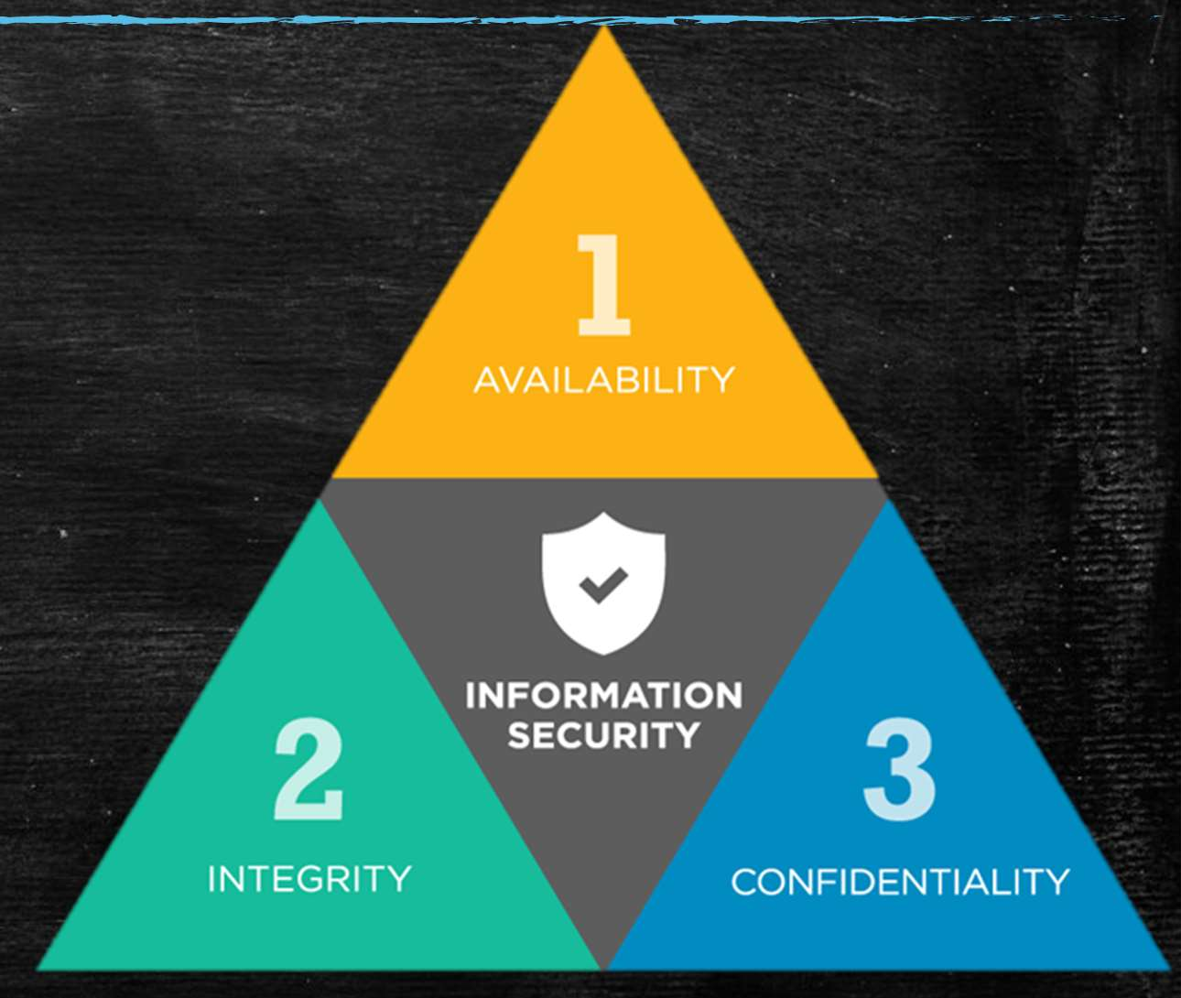
WHAT IS INFORMATION SYSTEMS SECURITY
“The protection of information and information systems against unauthorized access or modification of information, whether in storage, processing, or transit, and against denial of service to authorized users.
Information security includes those measures necessary to detect, document, and counter such threats. Information security is composed of computer security and communications security.”
INFORMATION SECURITY : CIA TRIAD

Slide 10
FIREWALL
Network security device that monitors incoming and outgoing network traffic
Permits or blocks data packets based on a set of security rules.

Slide 11
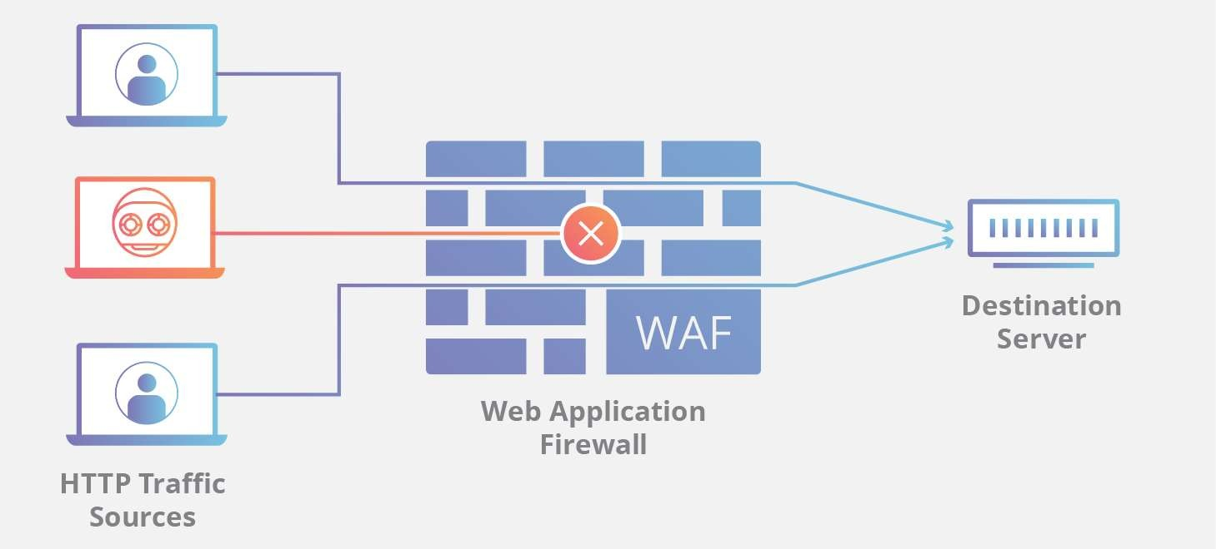
WEB APPLICATION FIREWALL

Slide 12
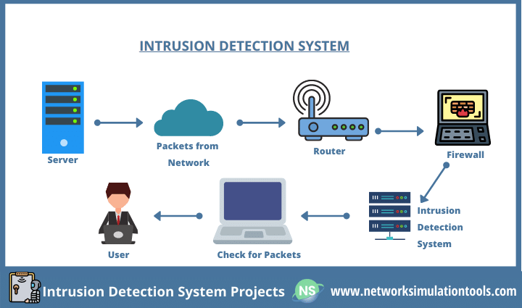
INTRUSION DETECTION SYSTEM (IDS)

Slide 13
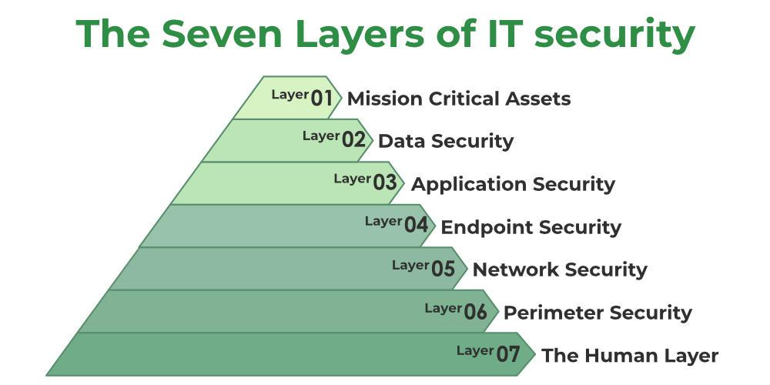
LAYERED SECURITY
consists of stacking security solutions, one on top of the other, to protect a computer from current, and zero day malware attacks.

Slide 14
CONSUMER LAYERED SECURITY STRATEGY
Backup
Operating System and Application Patch Management
Firewall
Antimalware
Antivirus
System Isolation
Zero Day Protection

Slide 15
ENTERPRISE LAYERED SECURITY STRATEGY
Technique of preventing to the enterprise from the failure and attack from the attacker and bugs to fulfill the desired result of any enterprise.
1. Physical Security
2. Network Security
3. Computer Hardening
4. Application Security
5. Device Hardening

Slide 16
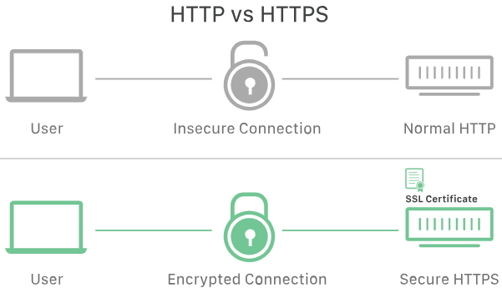
SECURE SOCKETS LAYER-CERTIFICATION
Security protocol that provides privacy, authentication, and integrity to Internet communications.
SSL eventually evolved into Transport Layer Security (TLS).
developed by Netscape in 1995

Slide 17
SECURE SOCKETS LAYER-CERTIFICATION
Digital certificate that authenticates a website's identity and enables an encrypted connection.
A security protocol that creates an encrypted link between a web server and a web browser.
WORKING:
A browser or server attempts to connect to a website (i.e., a web server) secured with SSL.
The browser or server requests that the web server identifies itself.
The web server sends the browser or server a copy of its SSL certificate in response.
The browser or server checks to see whether it trusts the SSL certificate. If it does, it signals this to the webserver.
The web server then returns a digitally signed acknowledgment to start an SSL encrypted session.
Encrypted data is shared between the browser or server and the webserver.
NEED of SSL CERTIFICATE:
Login credentials
Credit card transactions or bank account information
Personally identifiable information — such as full name, address, date of birth, or telephone number
Legal documents and contracts
Medical records
Proprietary information

Slide 18
TYPES OF SSL CERTIFICATE
Extended Validation certificates (EV SSL):highest-ranking and most expensive type of SSL certificate.
It tends to be used for high profile websites which collect data and involve online payments
2. Organization Validated certificates (OV SSL):second most expensive
primary purpose is to encrypt the user's sensitive information during transactions.
3. Domain Validated certificates (DV SSL): least expensive and quickest to obtain
used for blogs or informational websites – i.e., which do not involve data collection or online payments.
4. Wildcard SSL certificates: secure a base domain and unlimited sub-domains on a single certificate.
5. Multi-Domain SSL certificates (MDC): used to secure many domains and/or sub-domain names.
6. Unified Communications Certificates (UCC):Use to allow multiple domain names to be secured on a single certificate.
Life Span of SSL Certificate is No more than 27 Months

Slide 19
EXTENDED VALIDATION AND SSL-CERTIFICATION
EV certificate is a data security or anti-fraud measure recommended in 2006 by the Certificate Authority Browser Forum.
Certificate Authority/Browser Forum (CAB Forum): An open voluntary association of certification authorities and software developers.
The first version of the Extended Validation SSL Certificate Guidelines was ratified in June 2007.
The EV identity verification process requires the applicant to prove exclusive rights to use a domain, confirm its legal, operational and physical existence, and prove the entity has authorized the assurance of the Certificate.

Slide 20
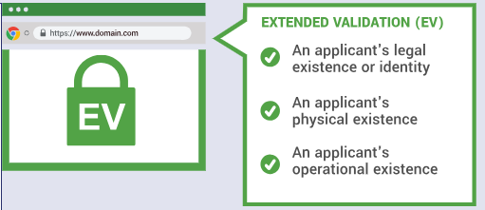
EXTENDED VALIDATION AND SSL-CERTIFICATION
EV certificate is a data security or anti-fraud measure recommended in 2006 by the Certificate Authority Browser Forum.
Certificate Authority/Browser Forum (CAB Forum): An open voluntary association of certification authorities and software developers.
The first version of the Extended Validation SSL Certificate Guidelines was ratified in June 2007.

Slide 21
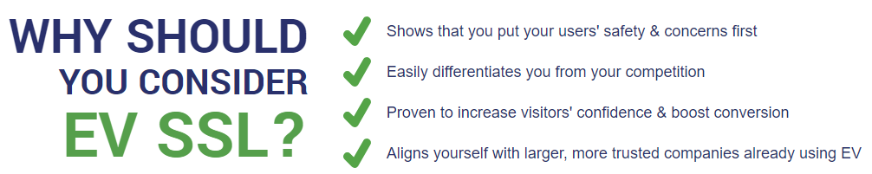
EXTENDED VALIDATION AND SSL-CERTIFICATION

Slide 22

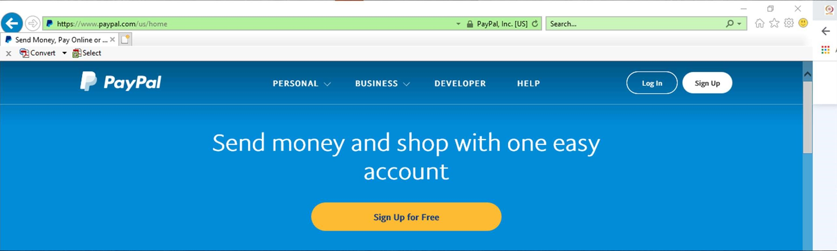
Assumed name, registered name and country
alternating with the issuer’s name
Padlock
Green address bar

Slide 23
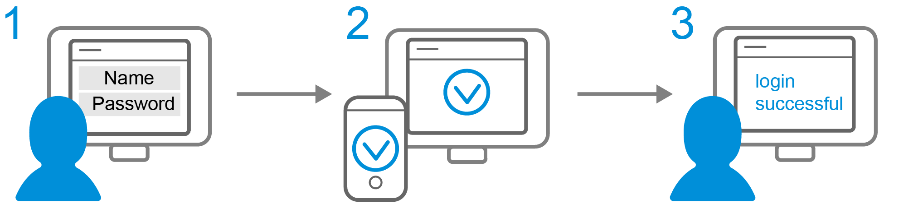
REMOTE ACCESS AUTHENTICATION
process whereby computer users can securely communicate with a network.
Remote access authentication protocols make it safer to conduct business online as well as use ATMs.

Slide 24
CONTENT CONTROL AND POLICY BASED ENCRYPTION
The Policy Based Encryption gateway automatically encrypts specific emails based on company-defined policies – that is, a set of rules designed to analyze all email, and encrypt any email that matches the pre-defined conditions.
The concept of policy-based encryption is a promising paradigm for trust establishment and authorization in large-scale open environments like the Internet and Mobile Networks.
On policy-based encryption which allow to encrypt a message according to a policy so that only entities fulfilling the policy are able to decrypt the message.

Slide 25
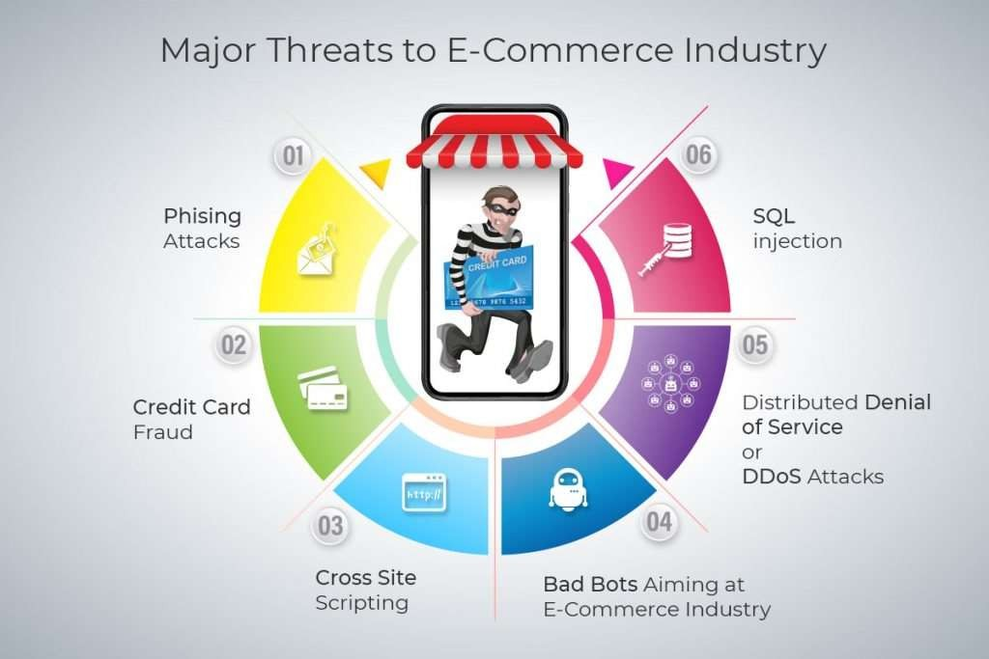
EXAMPLE OF SECURITY IN E-COMMERCE TRANSACTION

Slide 26
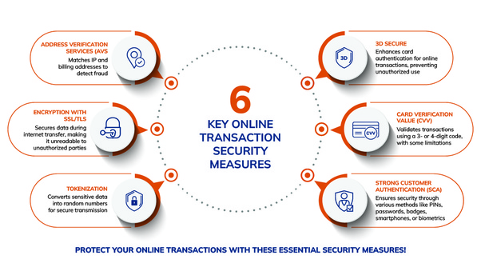
EXAMPLE OF SECURITY IN E-COMMERCE TRANSACTION

Slide 27
END of The UNIT 2

